Slide 1
Employee Payroll Management
RLL Project Team - 6

Slide 2
RLL Project Team – 6
Employee ID | Team Members
# | Durgappagari Vaishnavi
# | Jyothi S Ragate
# | Kotharu Ch Siva Satya Venkata Sai Krishna
# | P Benovin
# | Raghupathi Priyanka
# | Sujas Gupta
# | Agalya M
# | Pottapegula Sunil
# | Arpit Singh
# | Devisetty Reddy Navya

Slide 3
Table of contents
01
02
03
Introduction
Description
Services
04
Conclusion

Slide 4

Introduction
The Employee Payroll Management is a system that manages and maintains records of the employees
Admin can manage the application
Employees can use the application
And the end goal of the project is to create a microservice architecture for the same

Slide 5
Scope
The Scope of our project is as follows Employee should be able to:
Login and update timesheet
Apply for leave & view salary slips
Admin should be able to:
Manage Employee Information
Approve Leave and Manage Overall application

Slide 6

Technologies Used
Back End | Spring Cloud
Spring Data JPA | Spring Cloud Config
JDK 1.8 | Spring Cloud Netflix Eureka
Spring Boot | Feign
MySQL Database | Resilience4j
 | Sleuth & Zipkin

Slide 7
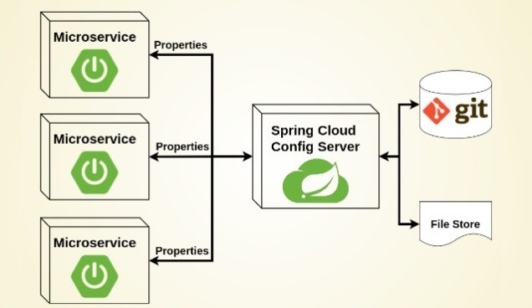
Spring Cloud Config Server
Imagine you have multiple microservices in your application, each with its own configuration settings like database connection details, feature toggles, or API endpoints. Keeping track of and managing these configurations can become complex, especially when you need to make changes across all services.
This is where Spring Cloud Config Server comes in. It acts as a central hub for storing and serving configurations to your microservices

Slide 8
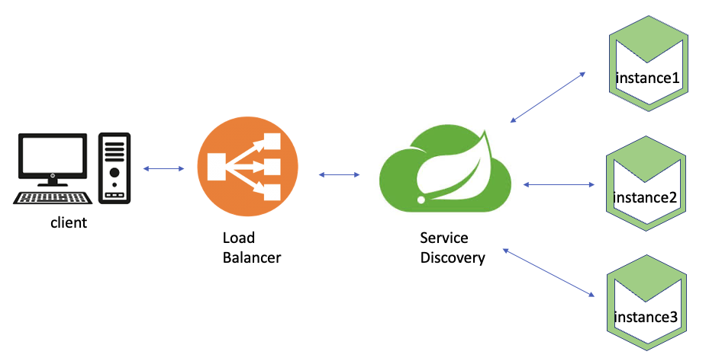
Spring Cloud Netflix Eureka
Imagine you have many microservices in your application, each performing a specific task like user authentication, data processing, or serving web pages. These microservices need to find and communicate with each other. However, in a dynamic and scalable environment, knowing where each microservice is located can be challenging.
This is where Spring Cloud Netflix Eureka comes in. It acts as a service registry or a directory that keeps track of all your microservices

Slide 9
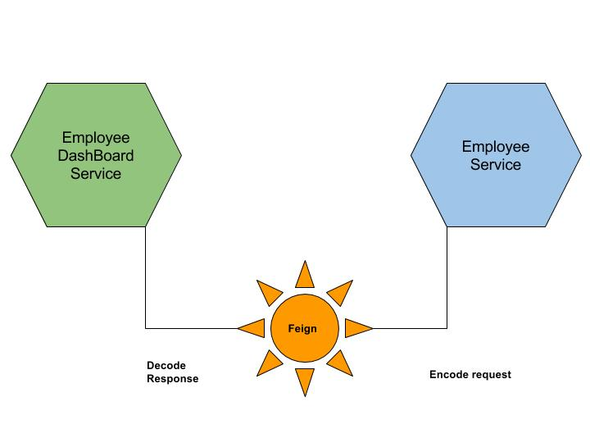
Feign Client
Imagine you have a microservices-based application, and different microservices need to communicate with each other over HTTP to exchange data or perform actions. Manually writing the code to make these HTTP requests can be repetitive and error-prone, especially when you have multiple services to interact with.
This is where Feign Client comes in. It simplifies the process of making HTTP requests to other services by providing a more intuitive and declarative (annotations) way to define and call RESTful APIs

Slide 10
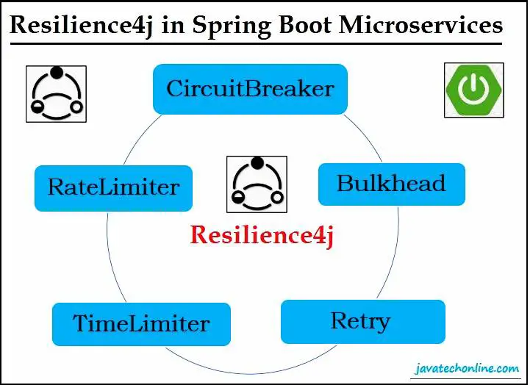
Resilience4j
Imagine you have a microservices-based application where different services interact with each other and external services over the network. In such a complex and dynamic environment, failures, such as network issues or service unavailability, can happen unexpectedly. Ensuring that your application continues to function despite these failures is crucial.
This is where Resilience4j comes in. It provides a toolkit for building resilient applications by helping you manage and control the interactions between your services

Slide 11
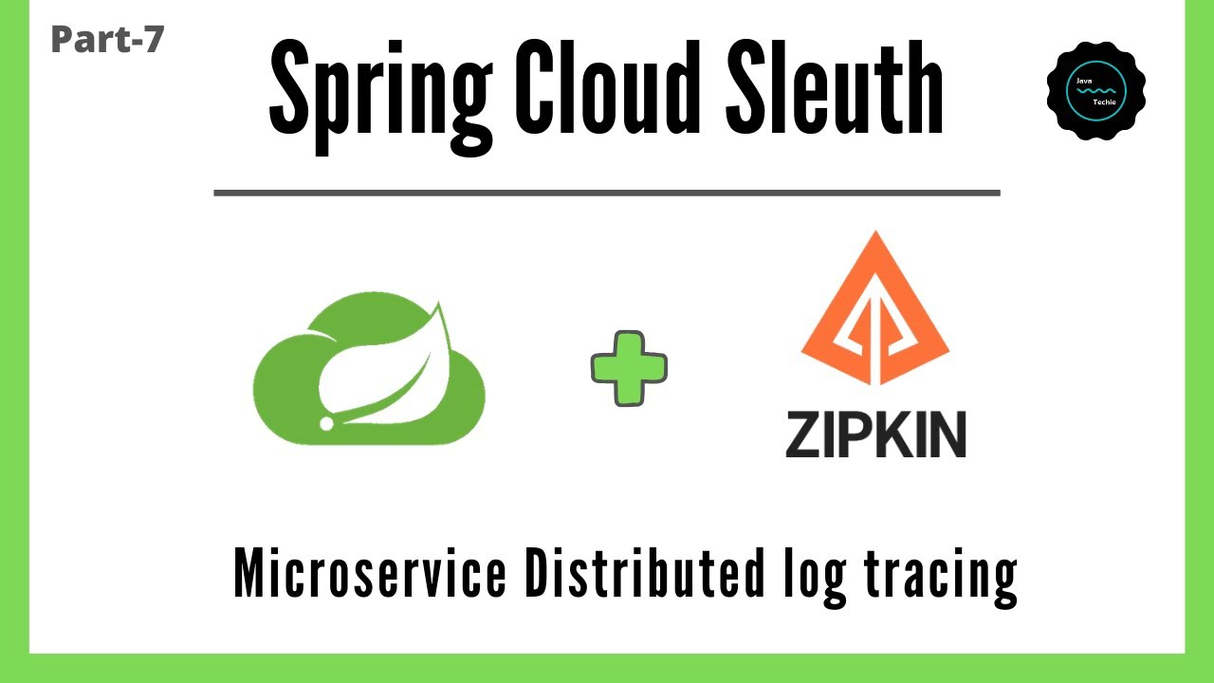





Sleuth & Zipkin
Imagine you have a complex microservices architecture with multiple services that communicate with each other to fulfill user requests. When a user interacts with your application, their request may bounce between several microservices before returning a response. If something goes wrong, such as slow response times or errors, it can be challenging to identify where the problem originated.
This is where Sleuth and Zipkin come to the rescue Sleuth (Distributed Tracing) Zipkin (Distributed Tracing Server)

Slide 12
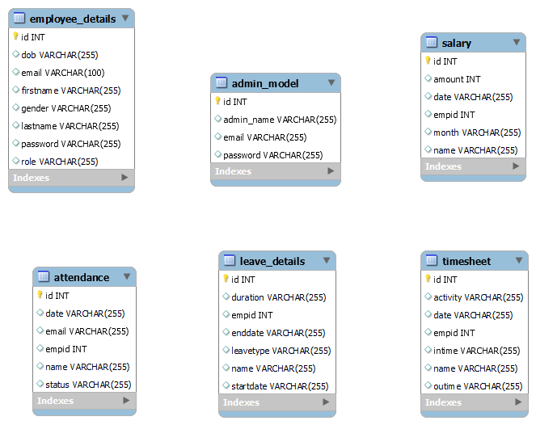
Entites

Slide 13
Services
Employee
Attendance
Admin
Login, Register Admin can manage
Admin can manage
Overall Management
Salary
Leave
Timesheet
Admin can add User can view
Admin can manage Applied by user
User can fill Admin can manage

Slide 14
01
Screenshots

Slide 15
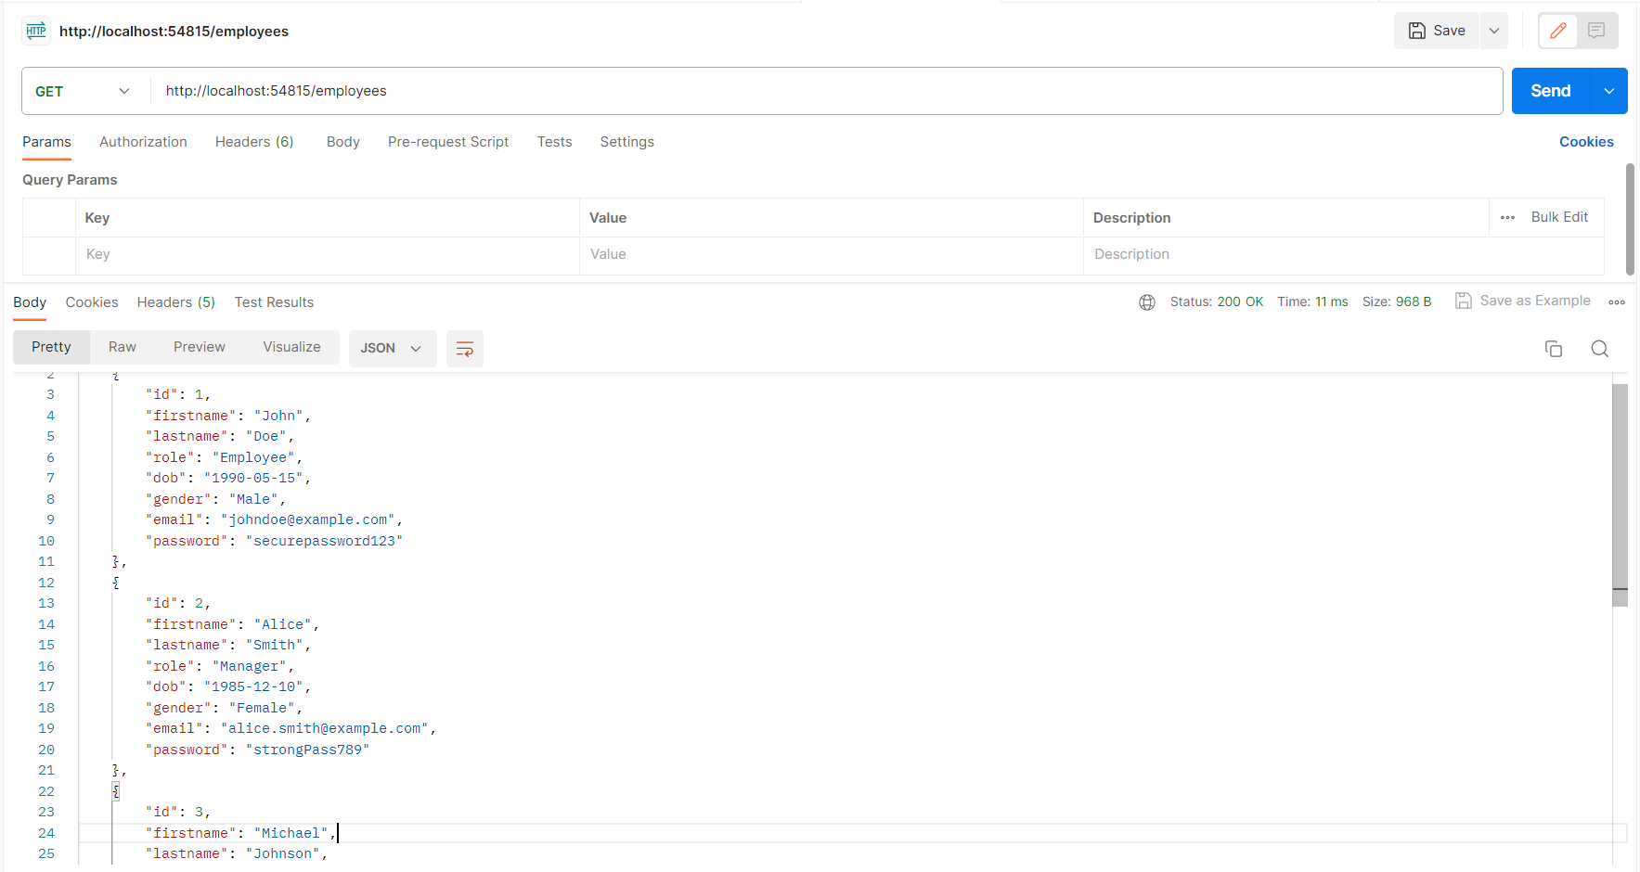
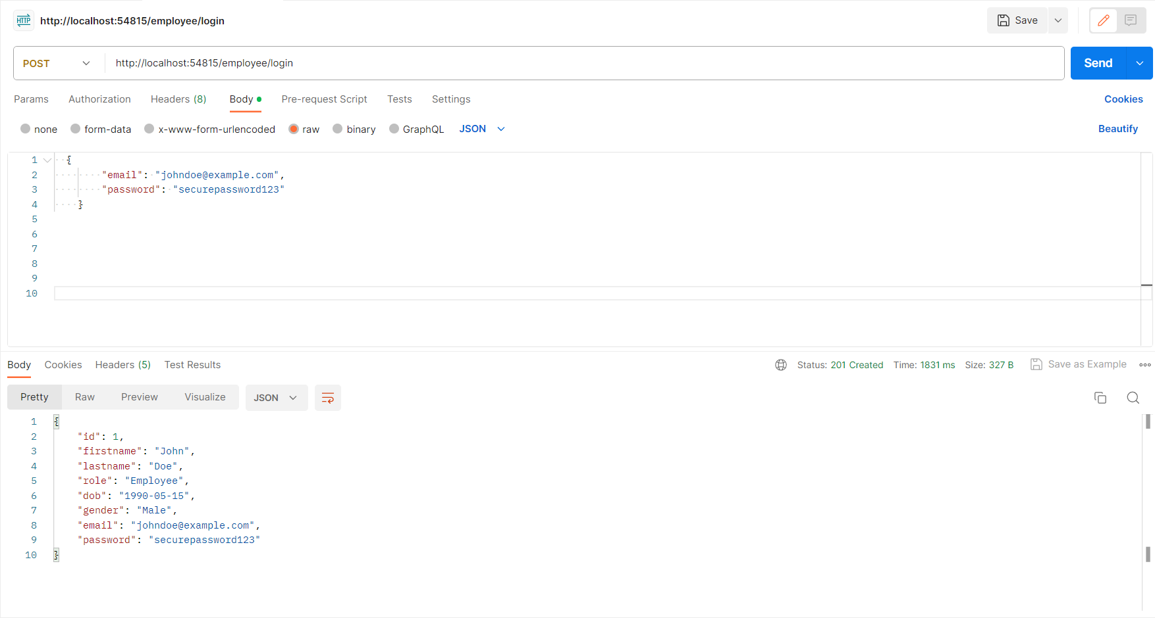
Employee Service

Slide 16
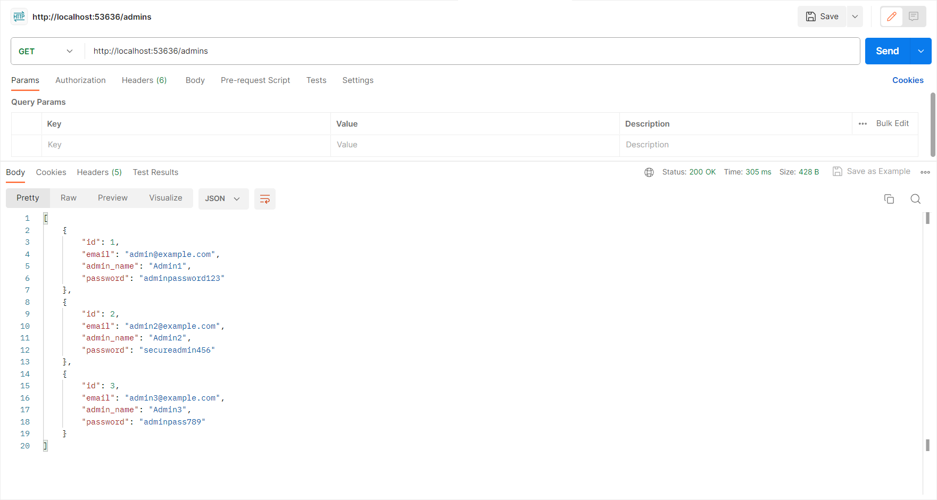
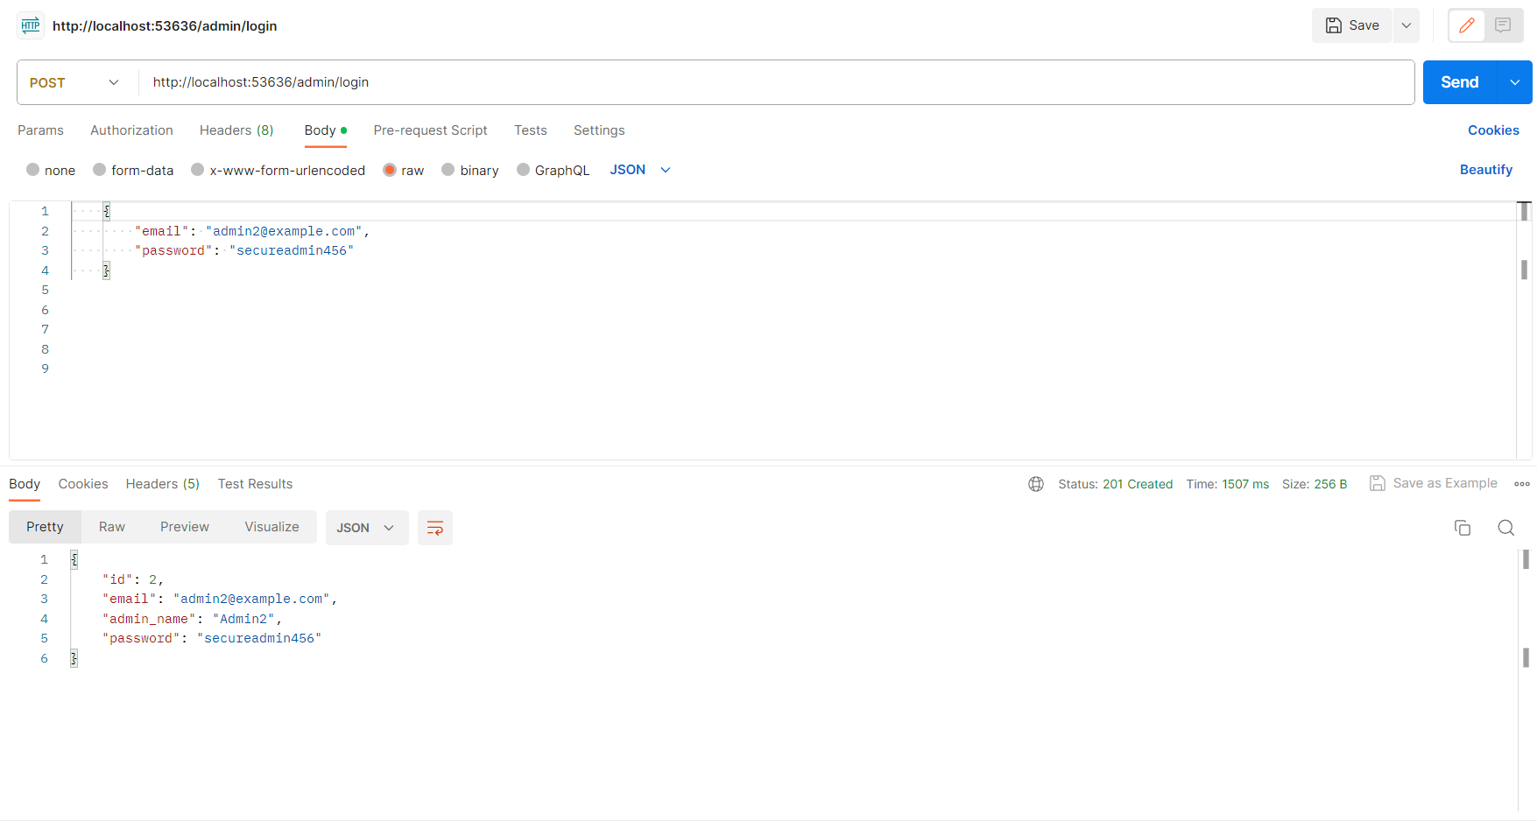
Admin Service

Slide 17
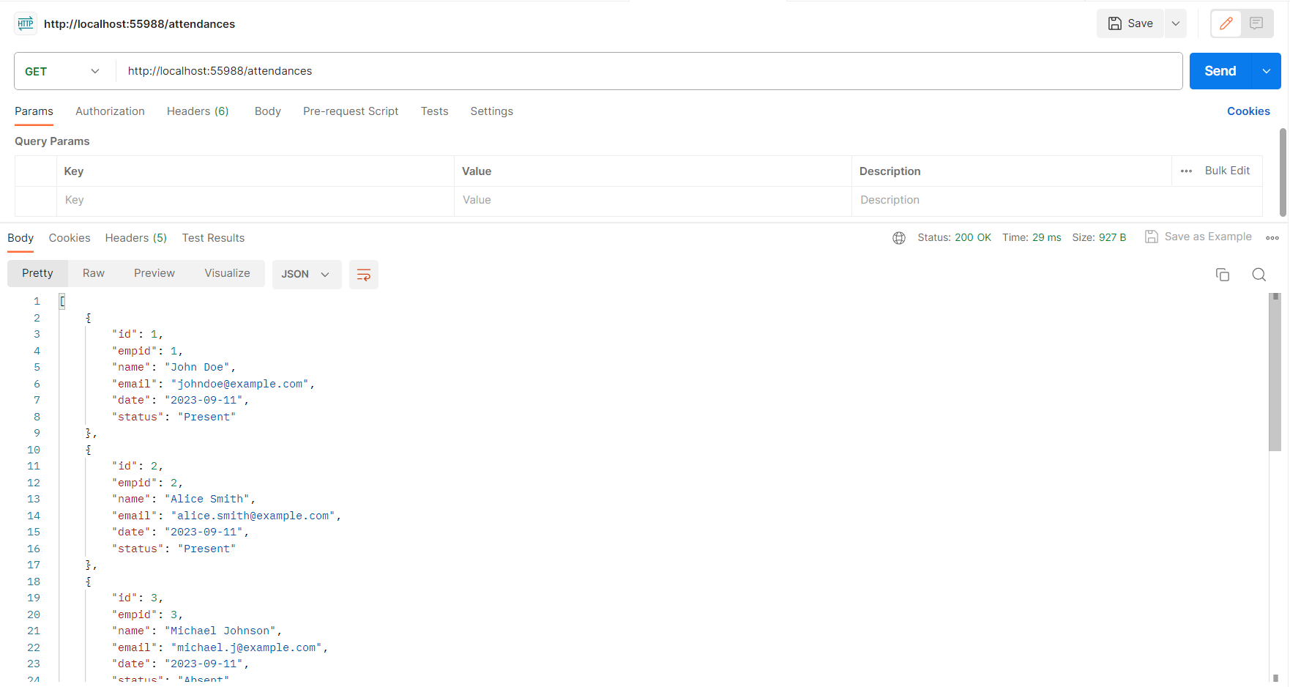
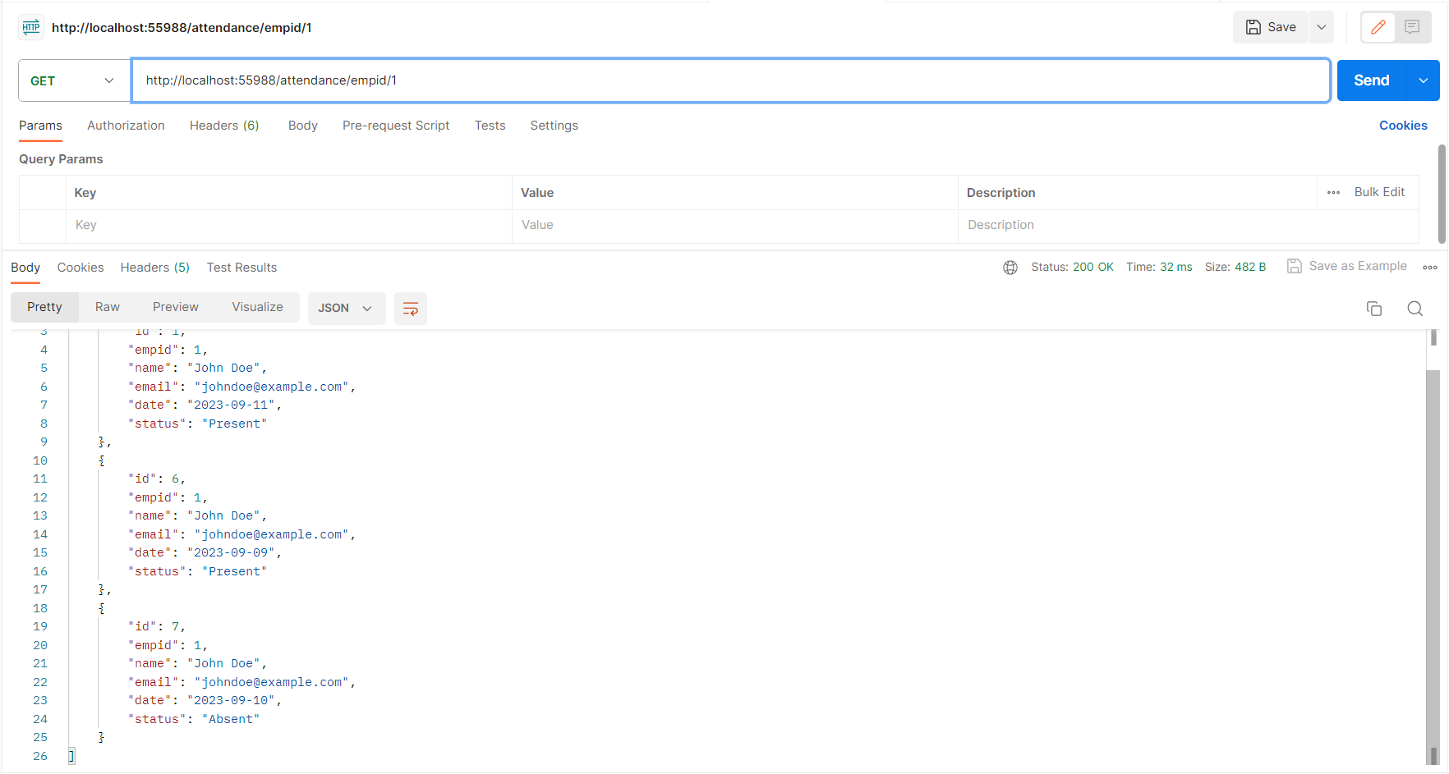
Attendance Service

Slide 18
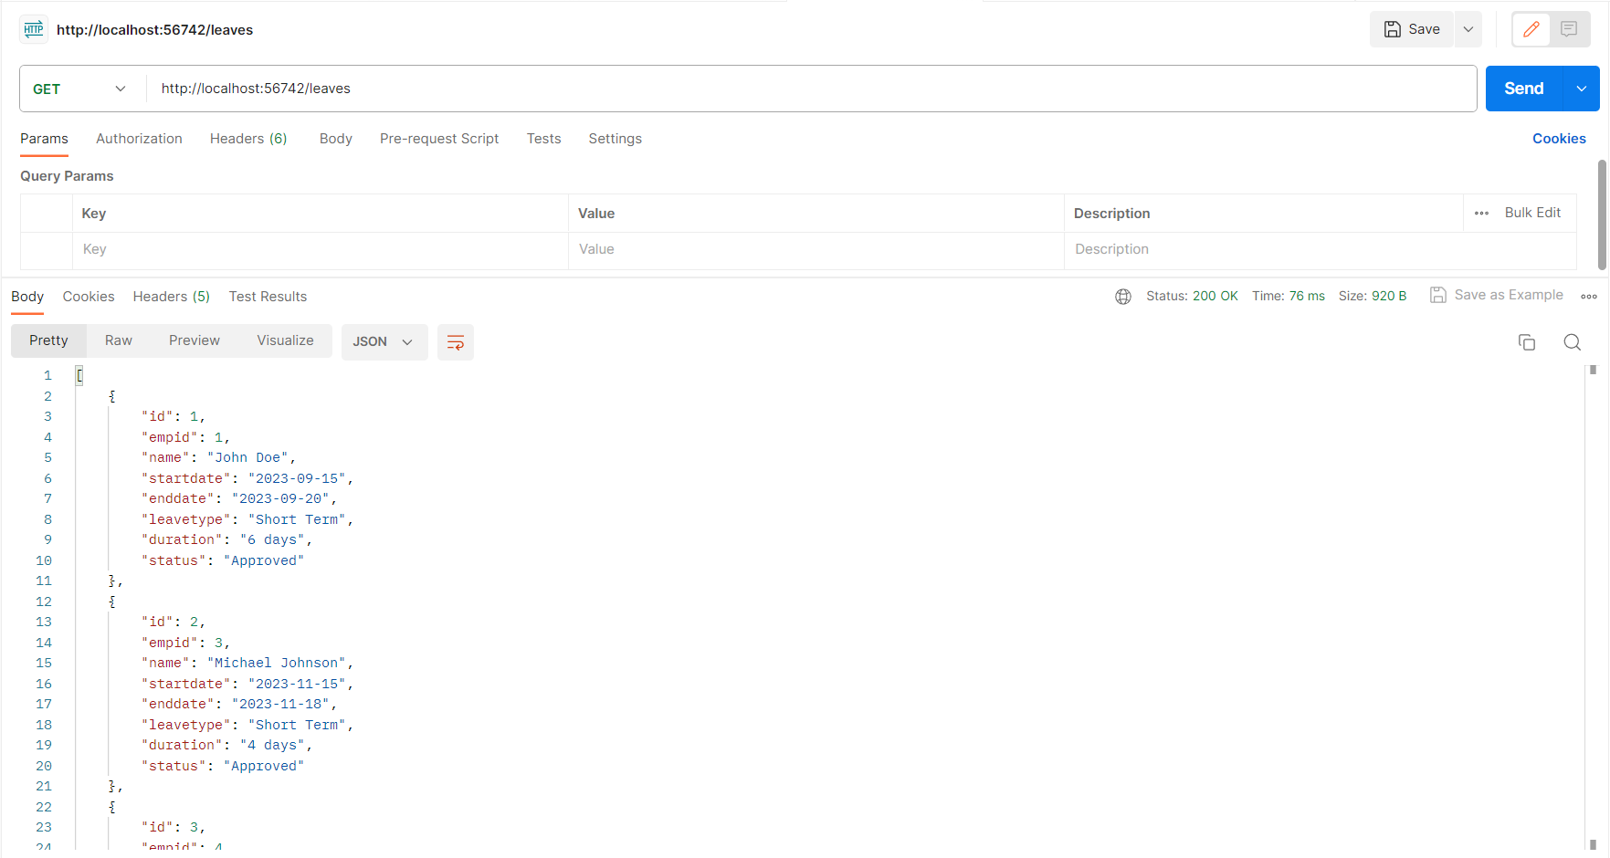
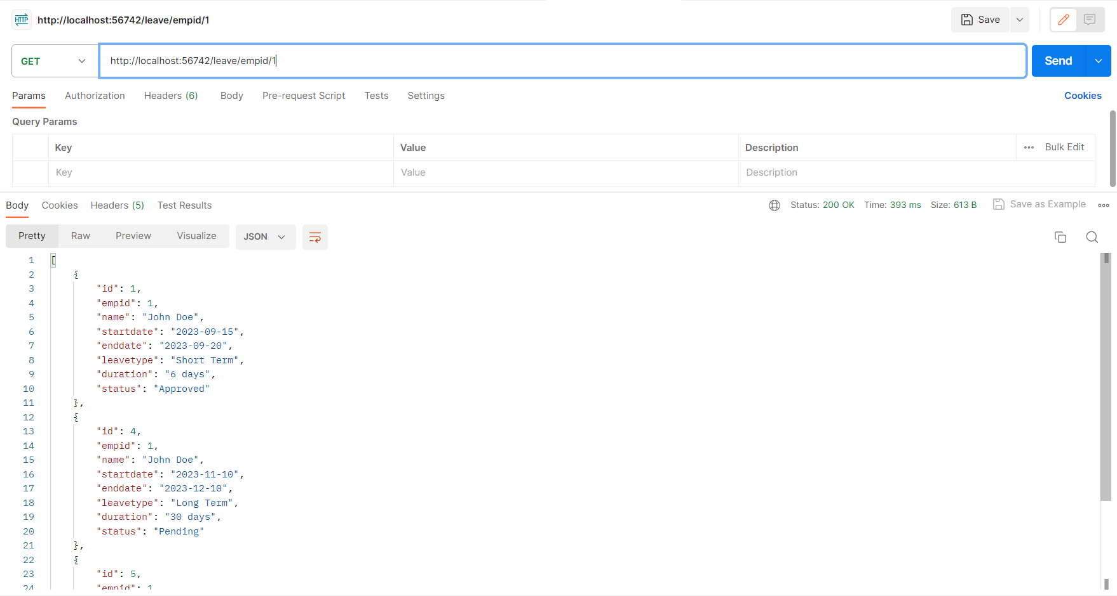
Leave Service

Slide 19

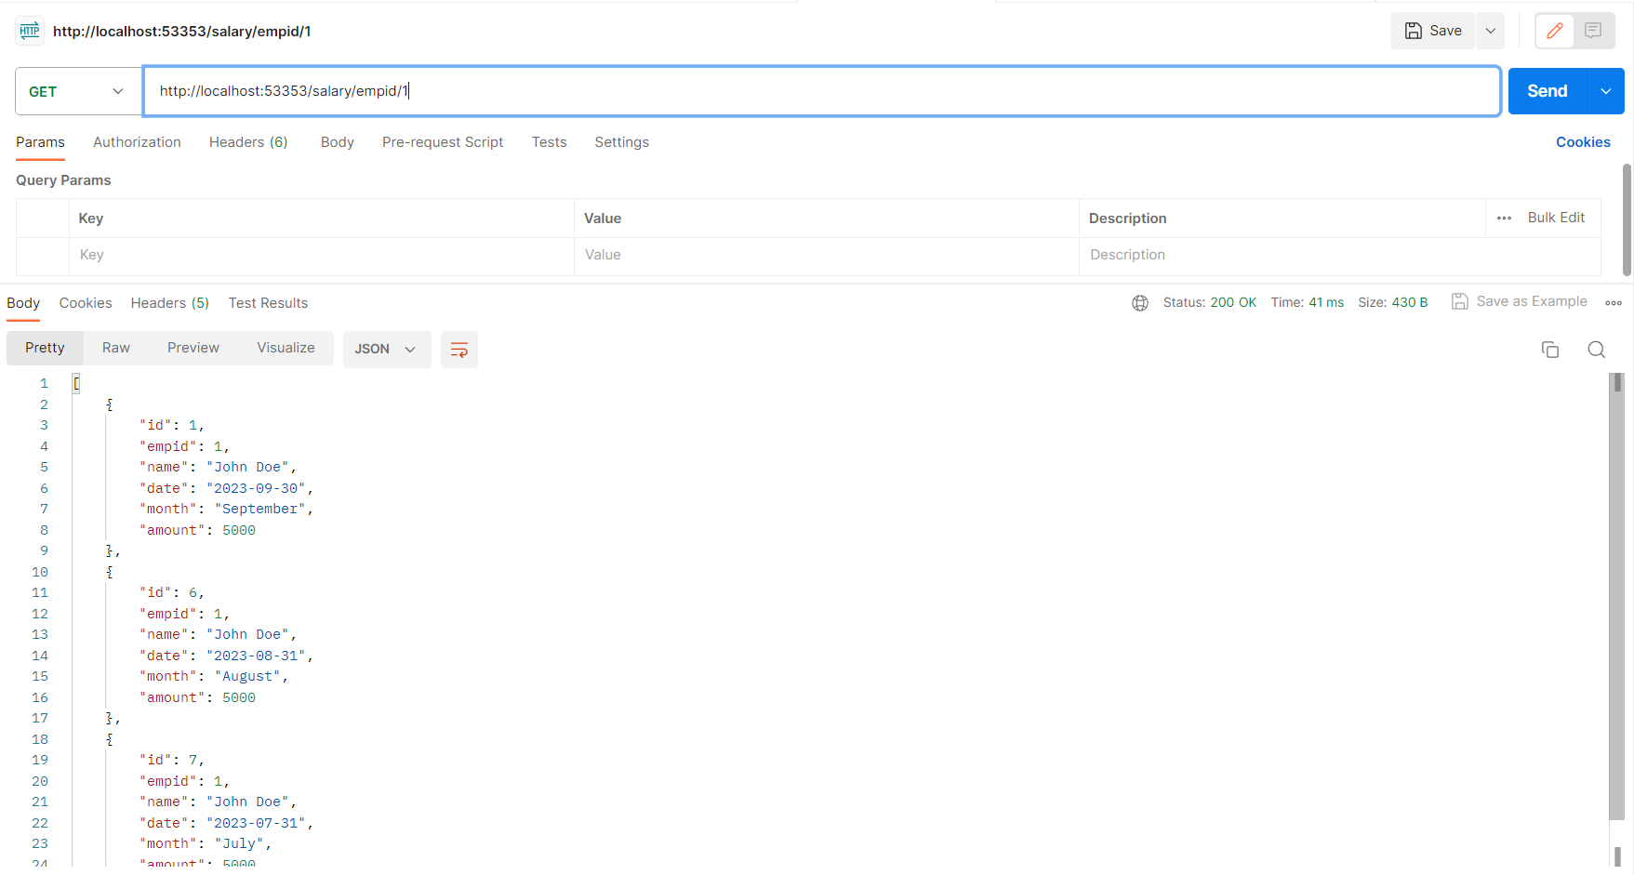
Salary Service

Slide 20
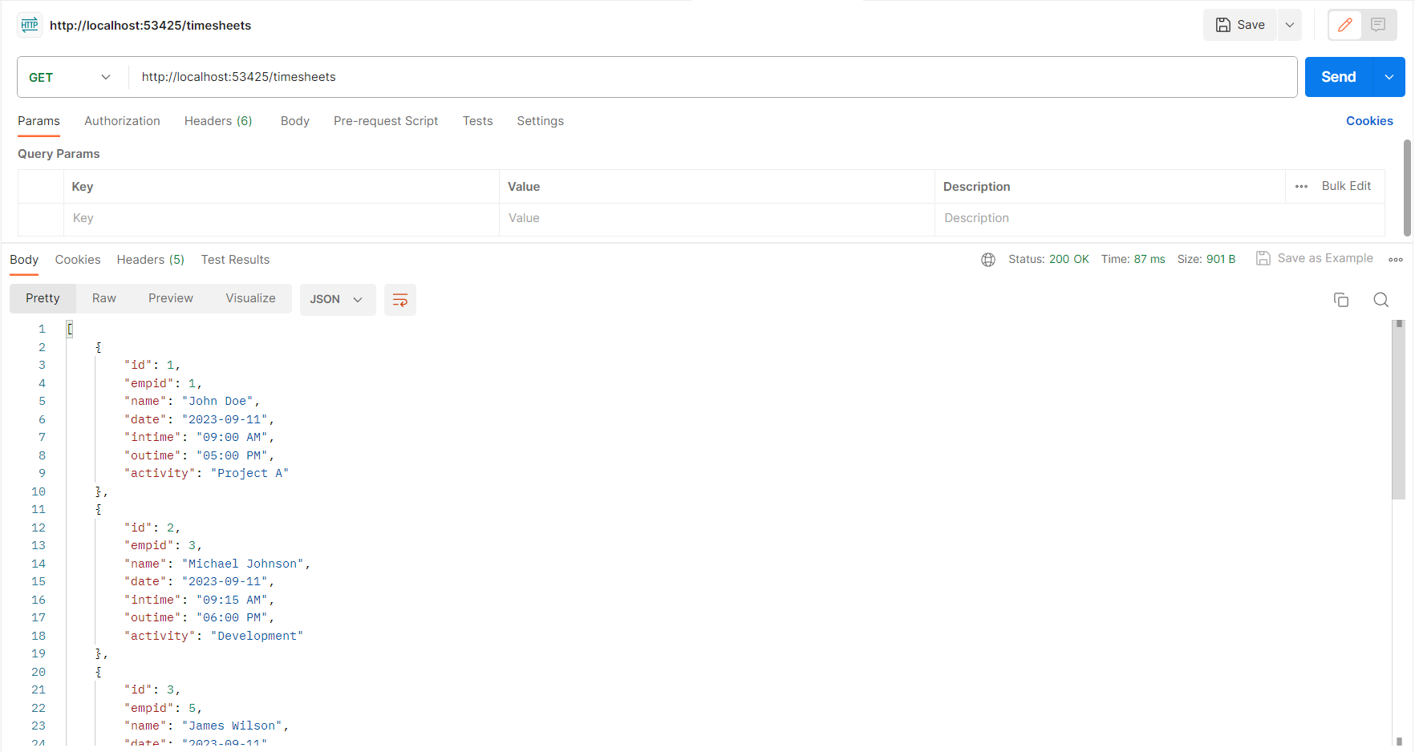
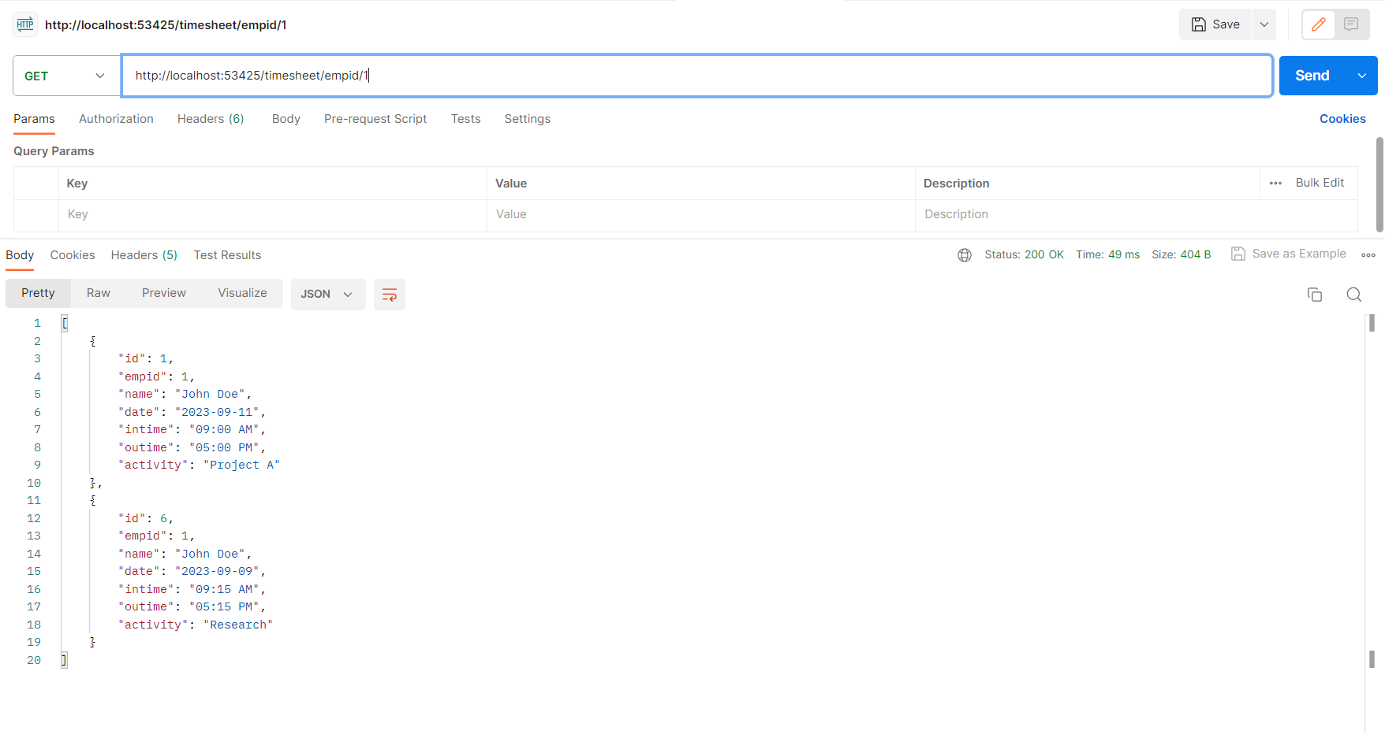
Timesheet Service

Slide 21
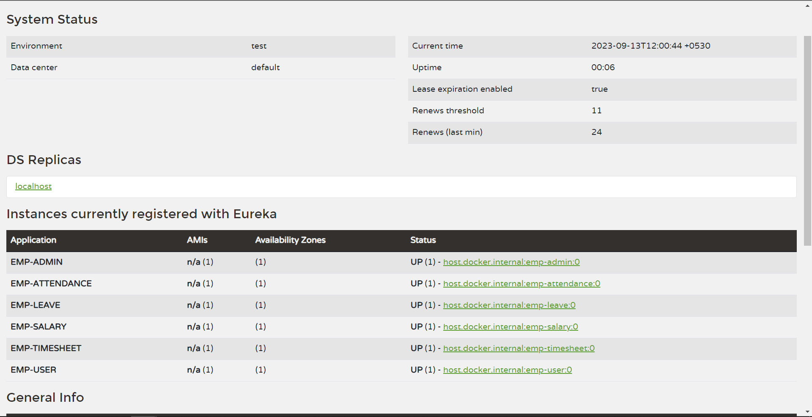
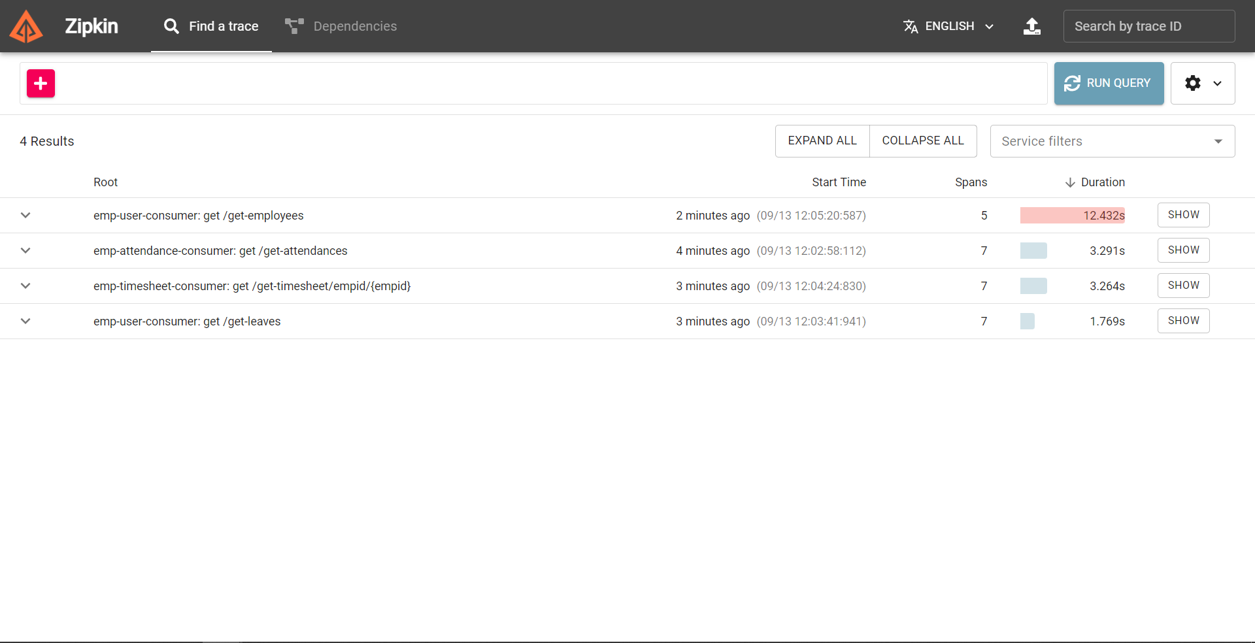
Service Registry & Zipkin

Slide 22

Conclusion
The end goal of the project was to create a microservice architecture for Employee Payroll Management which was accomplished
Best Practices were followed and future Scaling of the application is also viable

Slide 23
Thank You!

